Slide 1


Chương 6 - State Machine Diagram

Slide 2
Content
Introduction
States
Transitions
Types of events
Types of states
Entry and exit points

Slide 3
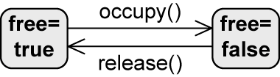
Introduction
Mỗi object có một số hữu hạn trạng thái trong chu trình sống
State machine diagram được sử dụng khi:
  Mô hình hóa các trạng thái có thể của 1 hệ thống hay 1 đối tượng
  Mô hình hóa các chuyển trạng xảy ra như là 1 chuỗi sự kiện
  Mô hình hóa hành vi của 1 hệ thống hay đối tượng ở 1 trạng thái
Example: high-level description of the behavior of a lecture hall
Transition
State

Slide 4
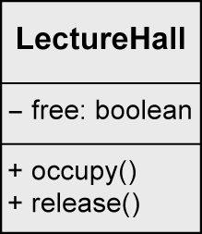
Example: Lecture Hall with Details
class LectureHall {
private boolean free;
public void occupy() {
free=false;
}
public void release() {
free=true;
}
}

Slide 5

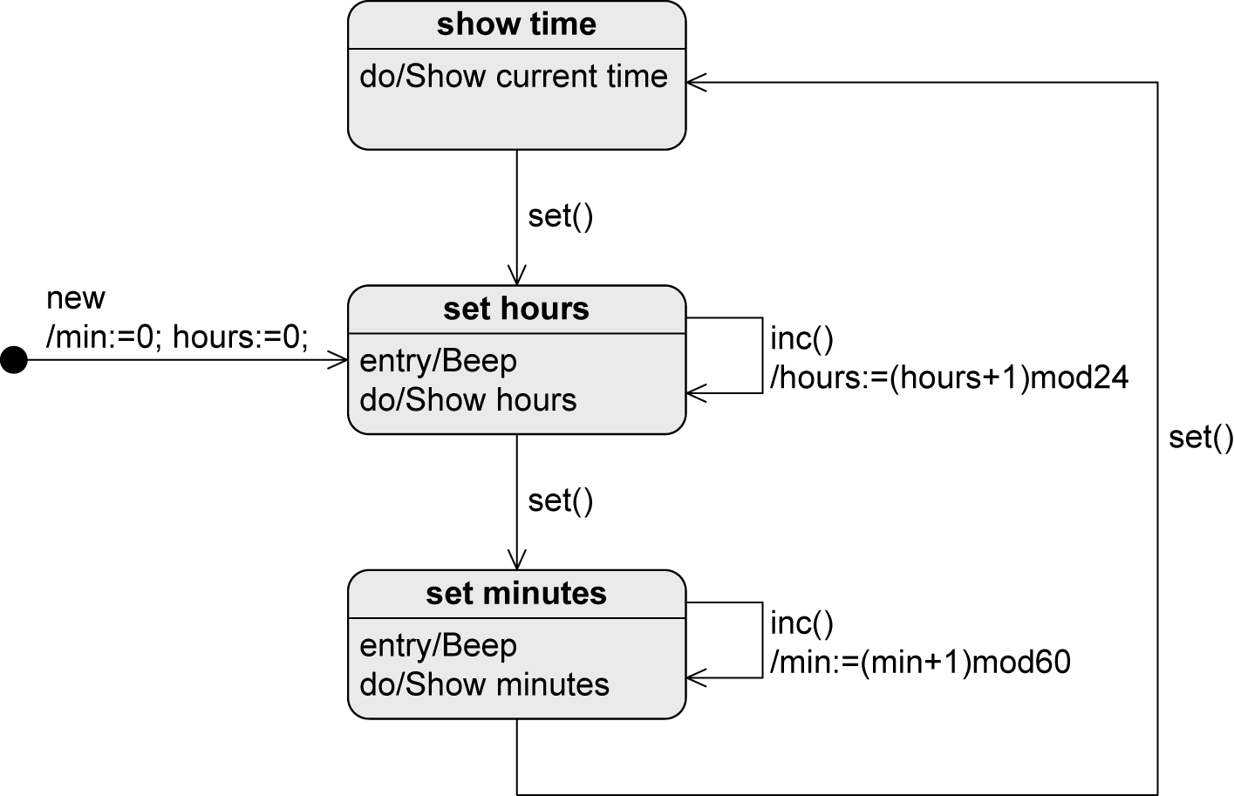
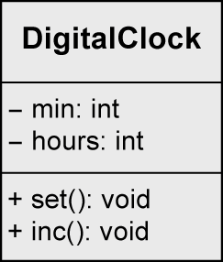

Example: Digital Clock

Slide 6
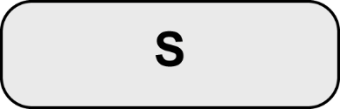
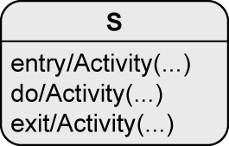
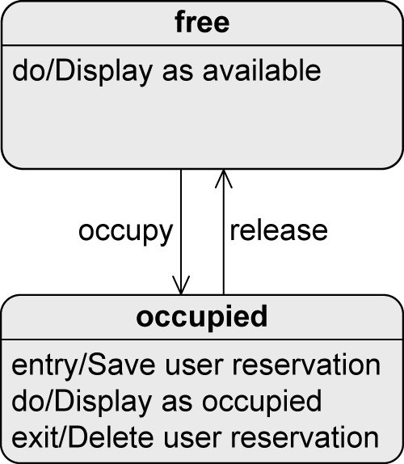
State
States = nodes of the state machine
(nút của máy trạng thái)
When a state is active
  The object is in that state
  All internal activities specified in this state can be executed
    An activity can consist of multiple actions
entry / Activity(...)
  Executed when the object enters the state
exit / Activity(...)
  Executed when the object exits the state
do / Activity(...)
  Executed while the object remains in this state
VD: khi 1 phòng học chuyển sang trạng thái bị
sử dụng, các hành vi nào hay xảy ra?

Slide 7

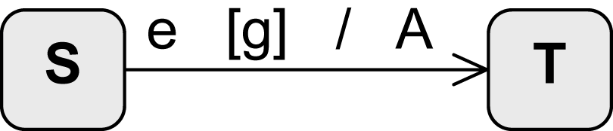
Transition
Change from one state to another
Event
(sự kiện)
Guard
Sequence of actions (effect)
Source state
(trạng thái nguồn)
Transition
(phép chuyển)
Target state
(trạng thái đích)

Slide 8
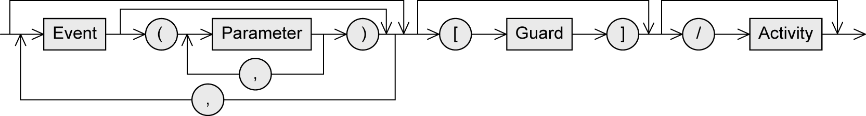
Transition – Syntax
Event (trigger) (sự kiện kích khởi)
  Exogenous stimulus (Kích khởi ngoại sinh)
  Can trigger a state transition
Guard (condition) (điều kiện bảo vệ)
  Boolean expression
  If the event occurs, the guard is checked
  If the guard is true
    All activities in the current state are terminated
    Any relevant exit activity is executed
    The transition takes place
  If the guard is false
    No state transition takes place, the event is discarded
Activity (effect) (Hành vi hệ quả)
  Sequence of actions executed during the state transition

Slide 9
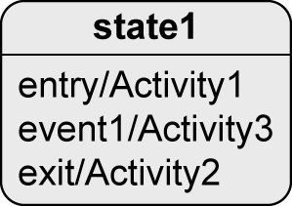
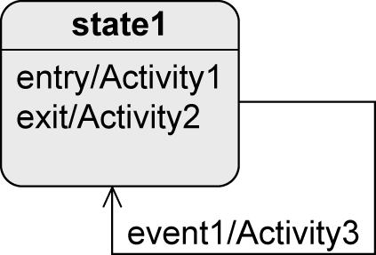
Transition – Types (1/2)
Internal transition
External transition
If event1 occurs
  Object remains in state1
  Activity3 is executed
If event1 occurs
  Object leaves state1 and Activity2 is executed
  Activity3 is executed
  Object enters state1 and Activity1 is executed

Slide 10




Transition – Types (2/2)
When do the following transitions take place?
If e1 occurs, A1 is aborted and the object
changes to S2
If e1 occurs and g1 evaluates to true, A1 is aborted and the object changes to S2
As soon as the execution of A1 is finished, a completion event is generated that initiates the transition to S2
As soon as the execution of A1 is finished, a completion event is generated; if g1 evaluates to true, the transition takes place; If not, this transition can never happen

Slide 11
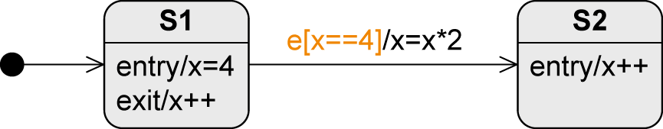
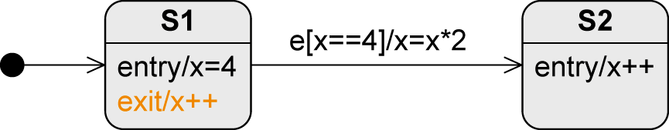
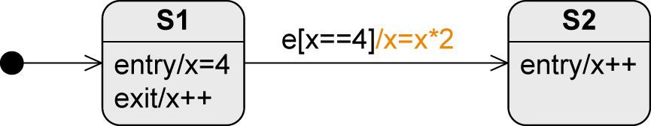
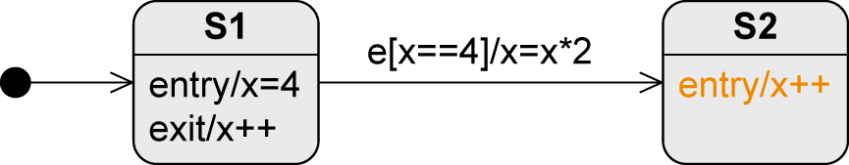
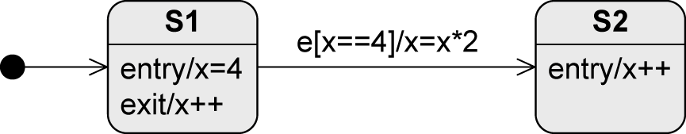
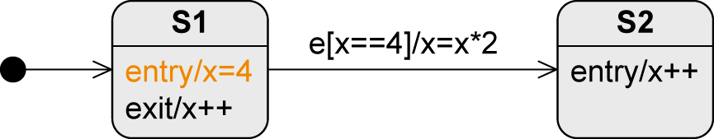
Transition – Sequence of Activity Executions
Assume S1 is active … what is the value of x after e occurred?
S1 becomes active, x is set to the value 4
e occurs, the guard is checked and evaluates to true
S1 is left, x is set to 5
The transition takes place, x is set to 10
S2 is entered, x is set to 11

Slide 12
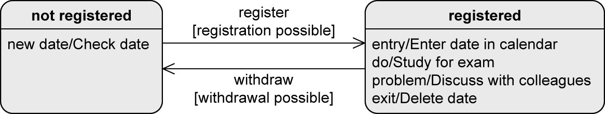
Example: Registration Status of an Exam

Slide 13
Event – Types (1/2)
Signal event
Receipt of a signal
  E.g., rightmousedown, sendSMS(message)
Call event
Operation call
  E.g., occupy(user,lectureHall), register(exam)
Time event
Time-based state transition
  Relative: based on the time of the occurrence of the event
    E.g., after(5 seconds)
  Absolute
    E.g., when(time==16:00), when(date==20150101)

Slide 14
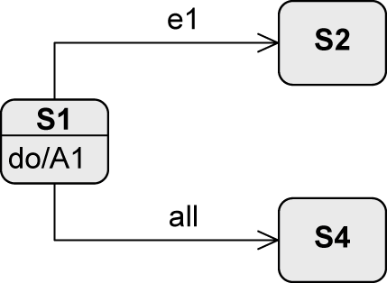
Event – Types (2/2)
Any receive event
Occurs when any event occurs that does not trigger another transition from the active state
  Keyword all
Completion event
Generated automatically when everything to be done in the current state is completed
Change event
Permanently checking whether a condition becomes true
  E.g., when(x > y), after(90min)

Slide 15
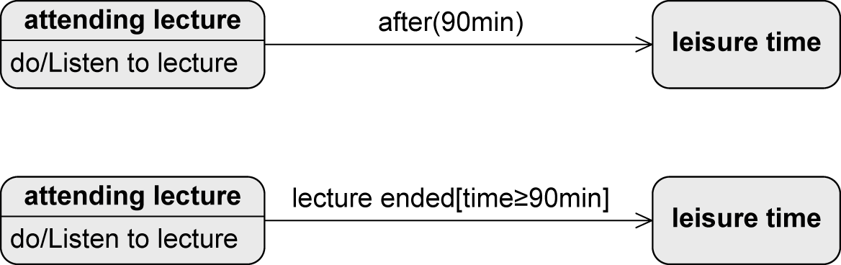
Change Event vs. Guard
Checked permanently
Only checked when event occurs
Question: What if the lecture is shorter than 90min?

Slide 16

Initial State
“Start” of a state machine diagram
Pseudostate
  Transient, i.e., system cannot remain in that state
  Rather a control structure than a real state
No incoming edges
If >1 outgoing edges
  Guards must be mutually exclusive(loại trừ lẫn nhau) and cover all possible cases to ensure that exactly one target state is reached
If initial state becomes active, the object immediately switches to the next state
  No events allowed on the outgoing edges (exception: new())

Slide 17


Final State and Terminate Node
Final State (trạng thái cuối)
Real state (trạng thái thật)
Marks the end of the sequence of states
Object can remain in a final state forever
Terminate Node (trạng thái ngừng)
Pseudostate (trạng thái ảo)
Terminates the state machine
The modeled object ceases to exist (= is deleted)

Slide 18
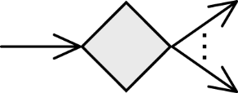
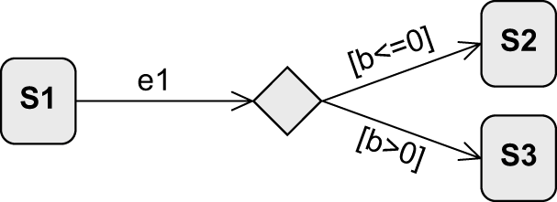
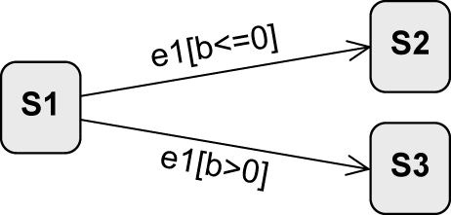
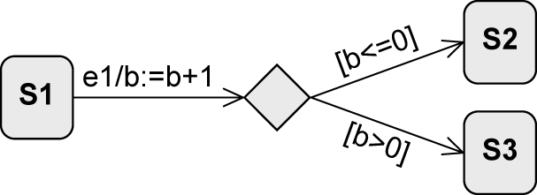
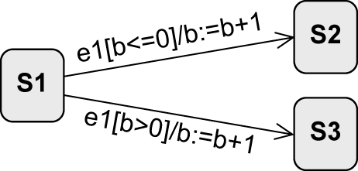
Decision Node (Nút quyết định)
Pseudostate (trạng thái ảo)
Used to model alternative transitions (dùng để mô hình các trạng thái lựa chọn)
equivalent?
=
equivalent?
≠

Slide 19
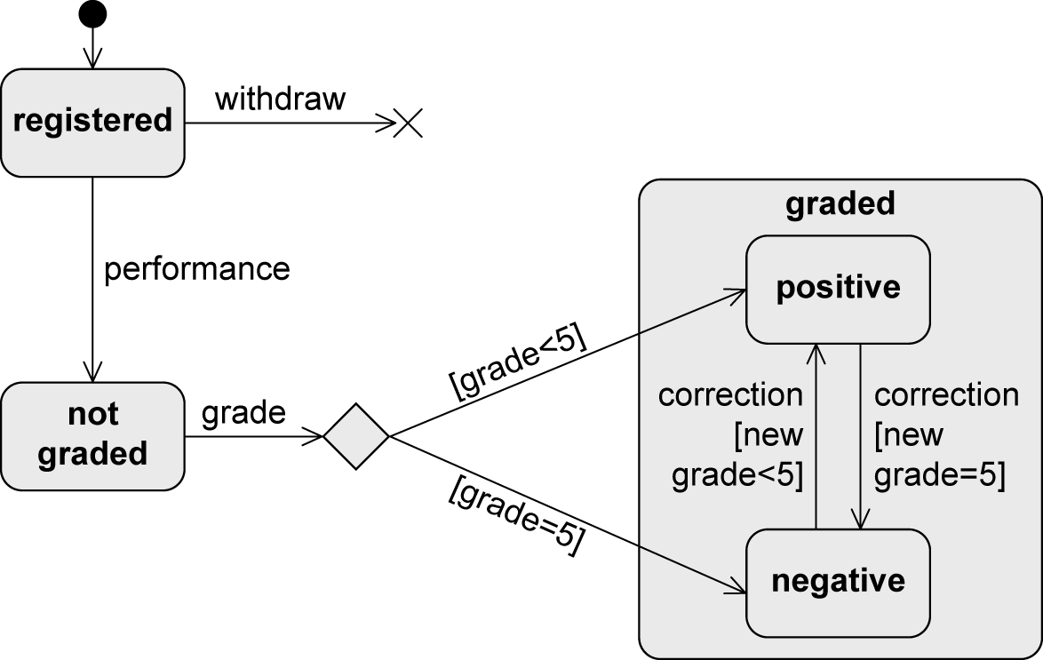
Example: Decision Node

Slide 20
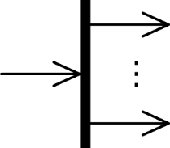
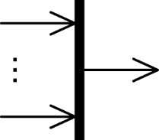
Parallelization and Synchronization Node
Parallelization node (nút song song)
Pseudostate
Splits the control flow into multiple concurrent flows
1 incoming edge
>1 outgoing edges
Synchronization node (nút đồng bộ)
Pseudostate
Merges multiple concurrent flows
>1 incoming edges
1 outgoing edge

Slide 21
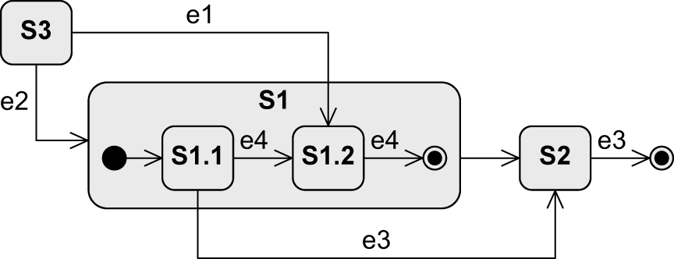
Composite State (trạng thái tổng hợp)
Synonyms: complex state (trạng thái phức hợp), nested state (trạng thái lồng)
Contains other states – “substates“
  Only one of its substates is active at any point in time
Arbitrary nesting depth of substates (cấp độ lồng phụ thuộc vào các substates)
Composite state
Substates

Slide 22
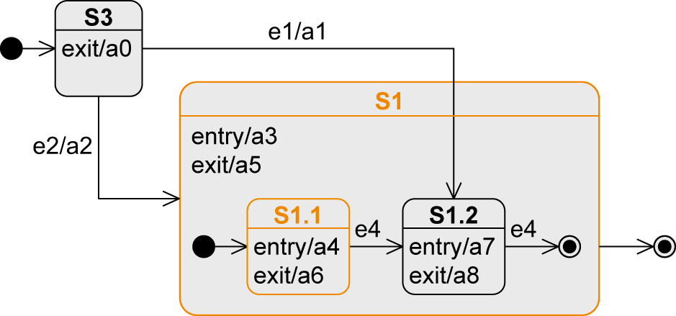
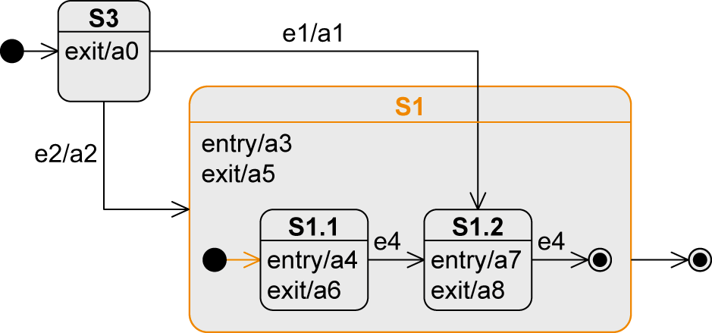
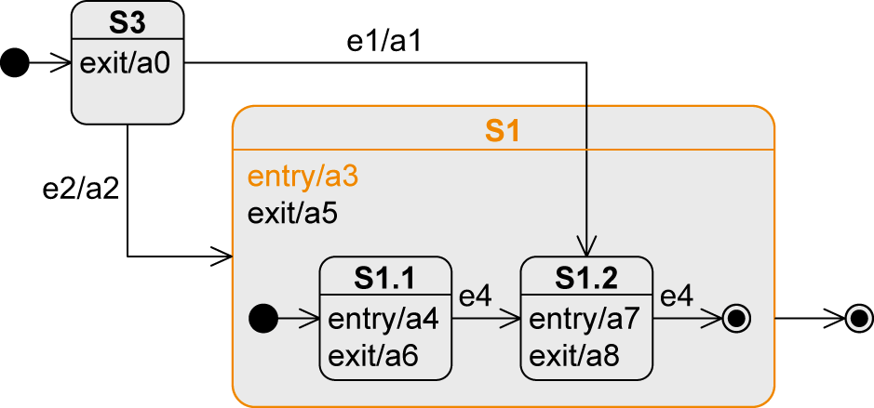
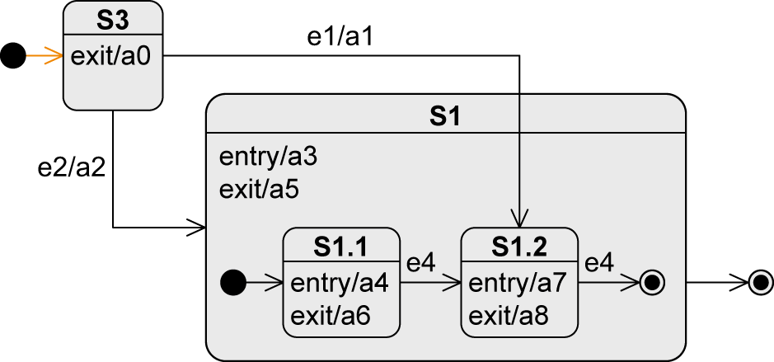
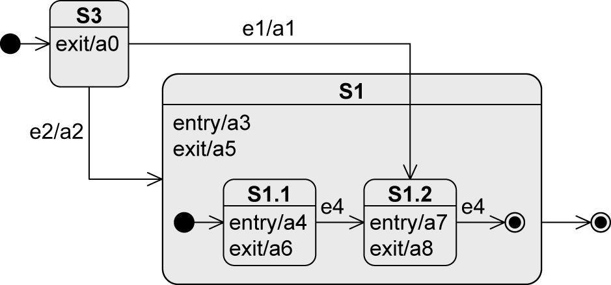
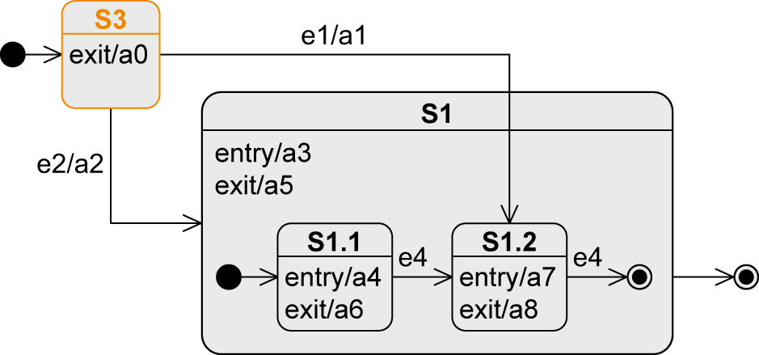
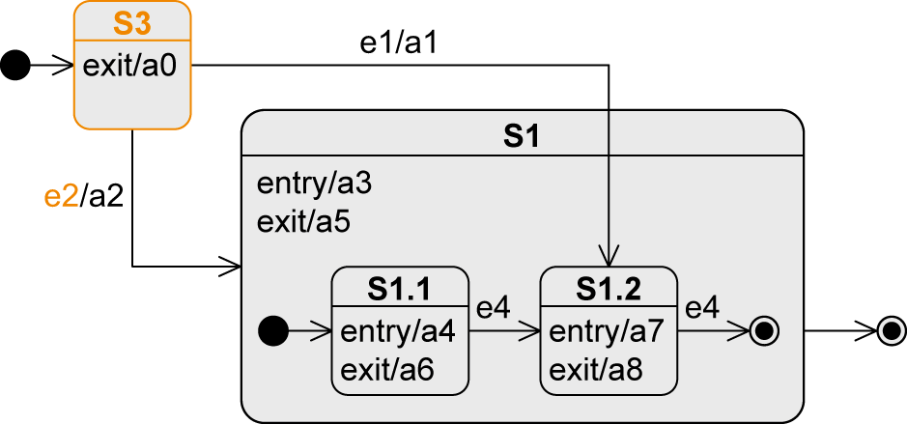
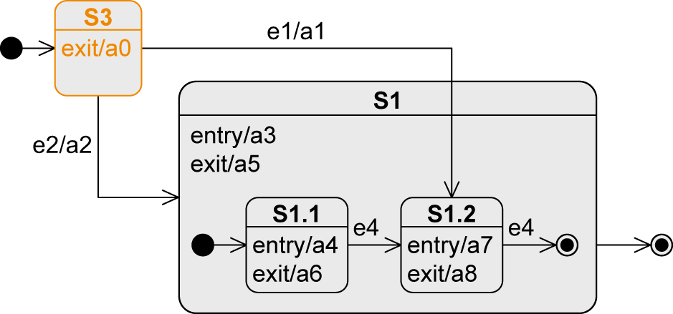
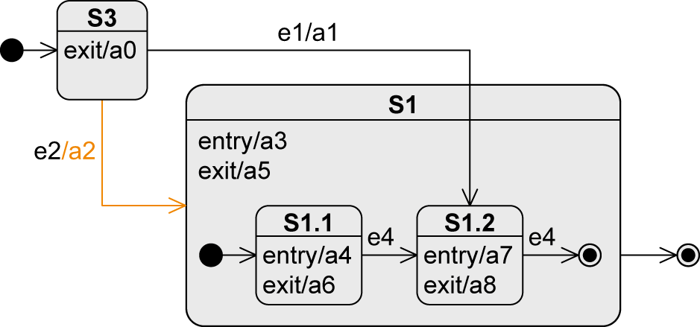
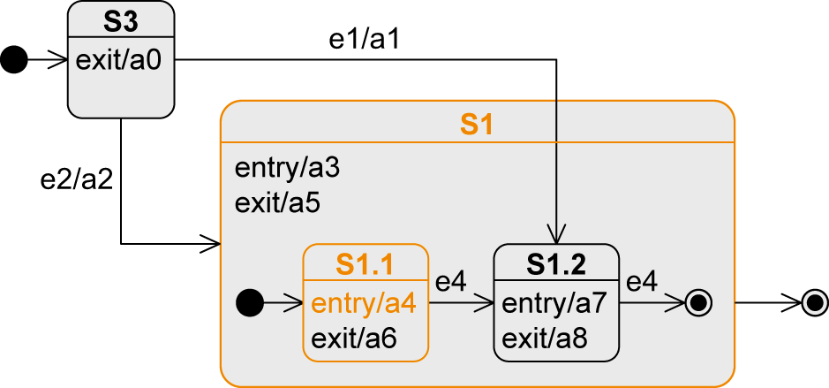
Entering a Composite State (1/2)
Transition to the boundary
  Initial node of composite state is activated
Event | State | Executed Activities
“Beginning“ | S3
e2 | S1/S1.1 | a0-a2-a3-a4

Slide 23
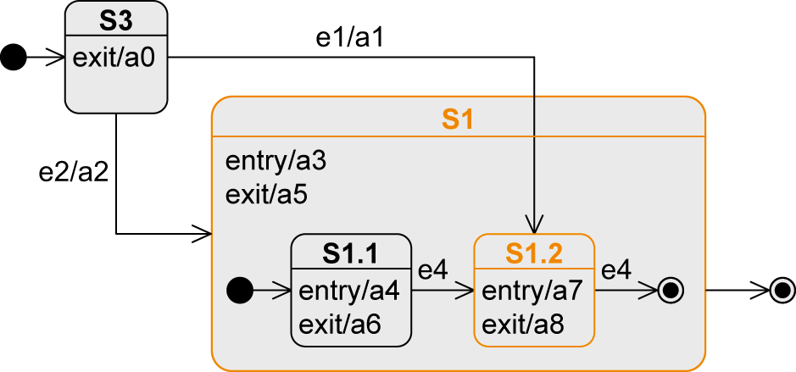
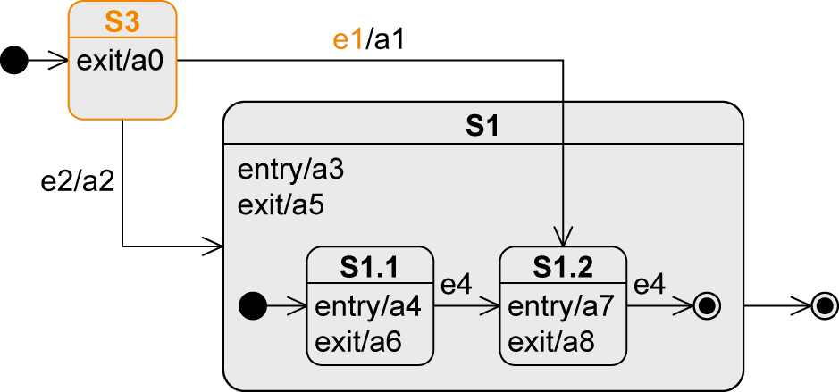
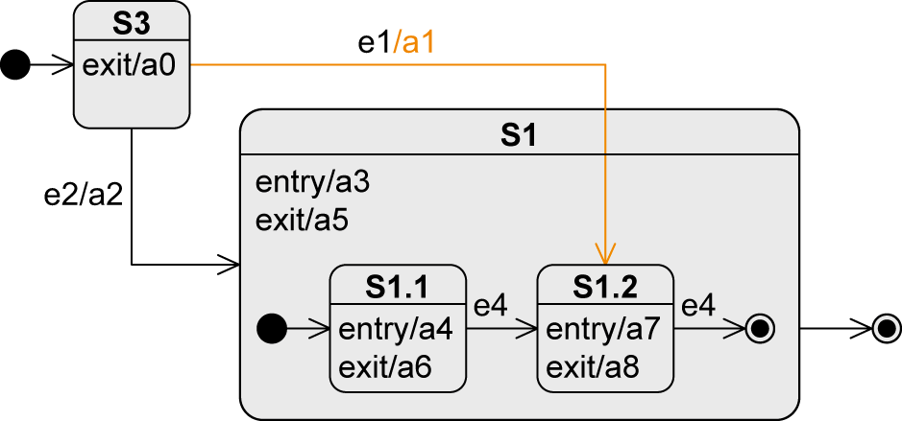
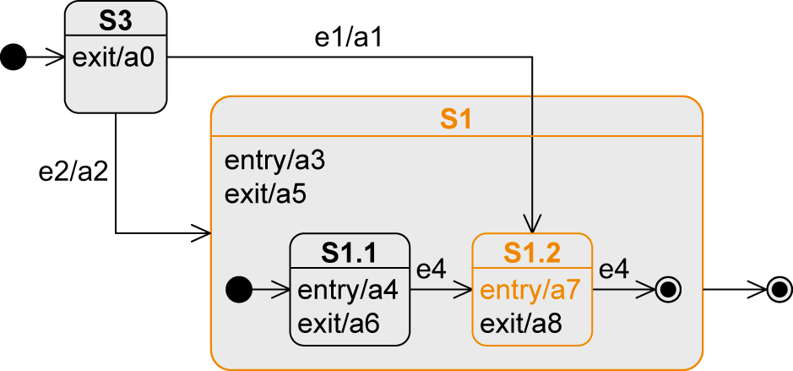
Entering a Composite State (2/2)
Transition to a substate
  Substate is activated
Event | State | Executed Activities
“Beginning“ | S3
e1 | S1/S1.2 | a0-a1-a3-a7
23

Slide 24
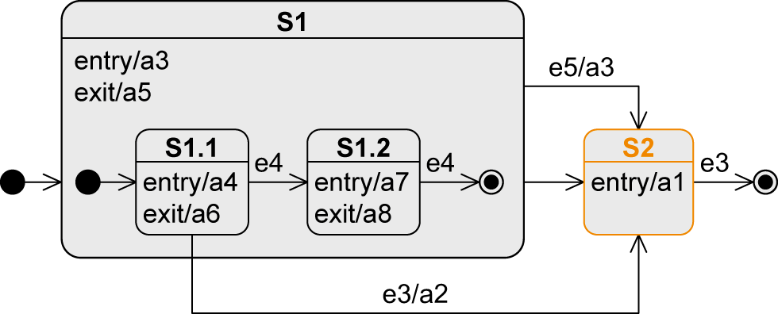
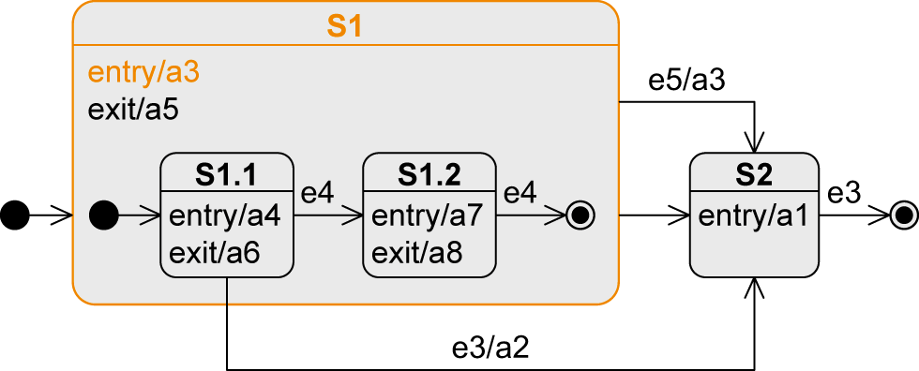
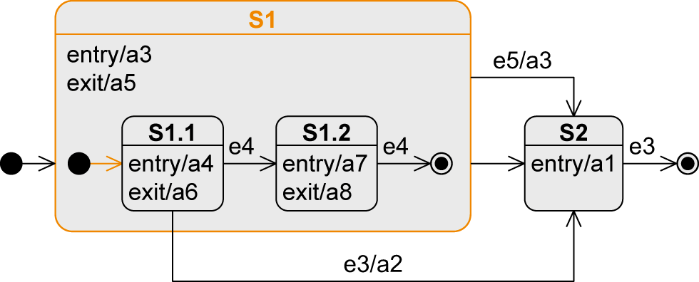
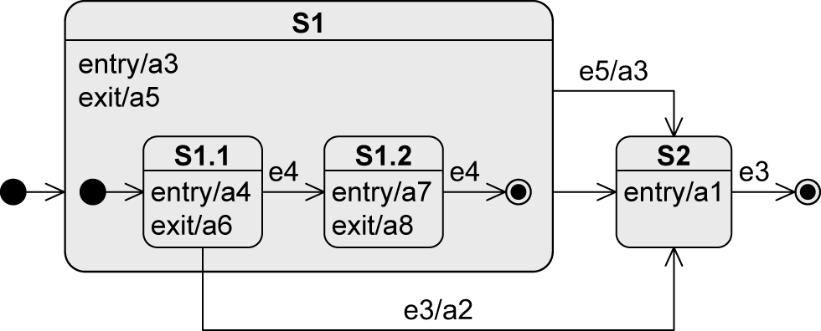
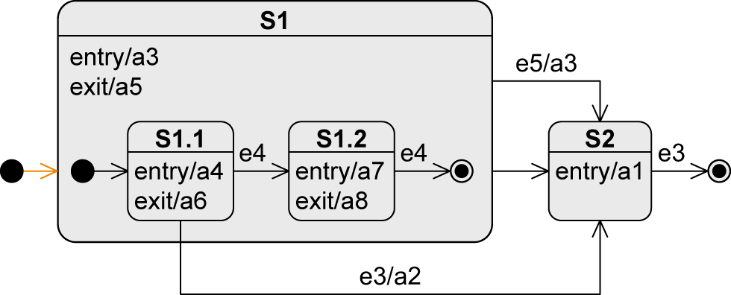
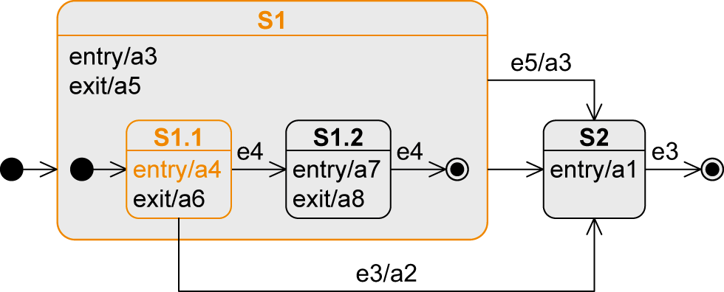
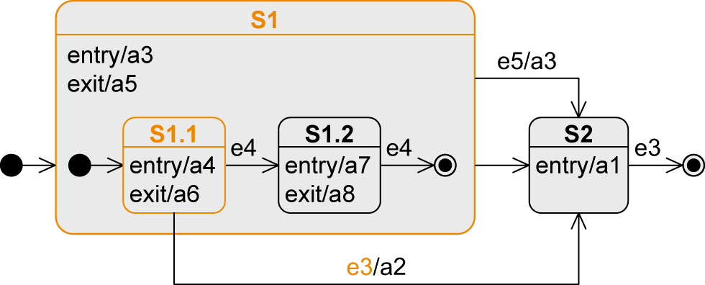




Exiting from a Composite State (1/3)
Transition from a substate
Event | State | Executed Activities
„Beginning“ | S1/S1.1 | a3-a4
e3 | S2 | a6-a5-a2-a1

Slide 25


Exiting from a Composite State (2/3)
Transition from the composite state
Event | State | Executed Activities
„Beginning“ | S1/S1.1 | a3-a4
e5 | S2 | a6-a5-a3-a1
No matter which substate of S1 is active, as soon as e5 occurs, the system changes to S2

Slide 26







Exiting from a Composite State (3/3)
Completion transition from the composite state
Event | State | Executed Activities
„Beginning“ | S1/S1.1 | a3-a4
e4 | S1/S1.2 | a6-a7
e4 | S2 | a8-a5-a1

Slide 27

Orthogonal State
Composite state is divided into two or more regions separated by a dashed line
One state of each region is always active at any point in time, i.e., concurrent substates
Entry: transition to the boundary of the orthogonal state activates the initial states of all regions
Exit: final state must be reached in all regions to trigger completion event
Using parallelization and synchronization node to enter different substates

Slide 28


Submachine State (SMS)
To reuse parts of state machine diagrams in other state machine diagrams
Notation: state:submachineState
As soon as the submachine state is activated, the behavior of the submachine is executed
  Corresponds to calling a subroutine in programming languages
Refinement symbol
(optional)

Slide 29


History State
Remembers which substate of a composite state was the last active one
Activates the “old” substate and all entry activities are conducted sequentially from the outside to the inside of the composite state
Exactly one outgoing edge of the history state points to a substate which is used if
  the composite state was never active before
  the composite state was exited via the final state
Shallow history state restores the state that is on the same level of the composite state
Deep history state restores the last active substate over the entire nesting depth

Slide 30

Example: History State (1/4)
Event | State
„Beginning“ | S5
e1 | S4/S1/S1.1
e2 | S1.2
e10 | S5
e9 | (H→) S1/S1.1

Slide 31
Example: History State (2/4)
Event | State
„Beginning“ | S5
e1 | S4/S1/S1.1
e2 | S1.2
e10 | S5
e8 | (H*→) S1.2

Slide 32
Example: History State (3/4)
Event | State
„Beginning“ | S5
e9 | (H→) S1/S1.1

Slide 33
Example: History State (4/4)
Event | State
„Beginning“ | S5
e8 | (H*→) S3/S3.1

Slide 34


Entry and Exit Points
Encapsulation mechanism
  A composite state shall be entered or exited via a state other than the initial and final states
  The external transition must/need not know the structure of the composite state
External view

Slide 35


Example: Entry and Exit Points

Slide 36

Notation Elements (1/2)
Name | Notation | Description
State |  | Description of a specific “time span” in which an object finds itself during its “life cycle”. Within a state, activities can be executed by the object.
Transition |  | State transition e from a source state S to a target state T
Initial state |  | Start of a state machine diagram
Final state |  | End of a state machine diagram
Terminate node |  | Termination of an object’s state machine diagram

Slide 37

Notation Elements (2/2)
Name | Syntax | Beschreibung
Decision node |  | Node from which multiple alternative transitions can origin
Parallelization node |  | Splitting of a transition into multiple parallel transitions
Synchronization node |  | Merging of multiple parallel transitions into one transition
Shallow / deep history state |  | “Return address” to a substate or a nested substate of a composite state

Slide 38

Câu hỏi ?
Notes:
Nguồn: www.clipartkid.com

